Slide 1
Optimizing Orthogonal Sparse Autoencoders with CUDA
High-Performance Computing Course Project
Anton Korznikov

Slide 2
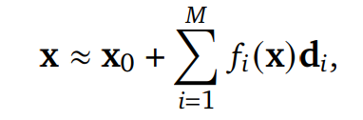
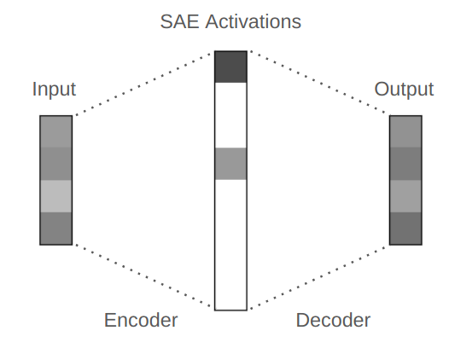
Sparse Autoencoders
Superposition hypothesis:
embedding vector of token [Jordan] in residual stream in 8th layer of GPT2

Slide 3
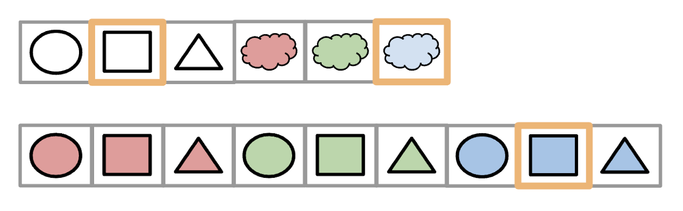
SAE features are not atomic. Theoretical evidence.
L0 regularization conflicts with reconstruction loss.
Atomic SAE
high L0 norm
Non-atomic SAE
low L0 norm

Slide 4
Problem: current SAEs learn non-atomic features Hypothesis: atomic features are almost orthogonal Solution: add orthogonal regularization on features

Slide 5
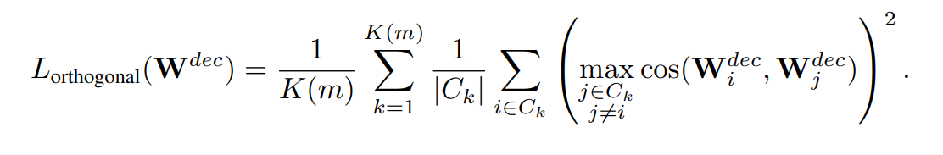
Orthogonal loss calculation
At every iteration divide all decoder vectors on 32 random chunks.
Compute Gramm matrix for every chunk.
Using Gramm matrix compute for every decoder vector cos_sim to its closest decoder vector.
Square this cos_sims and sum over all decoder columns and chunks.

Slide 6
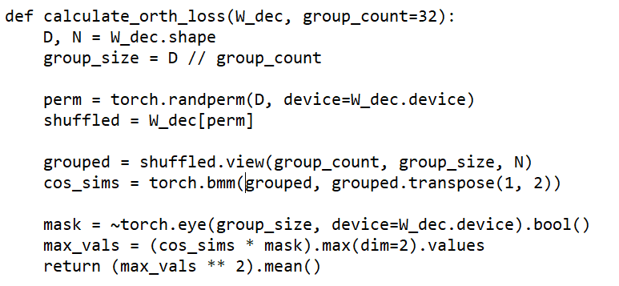
Python + PyTorch implementation

Slide 7
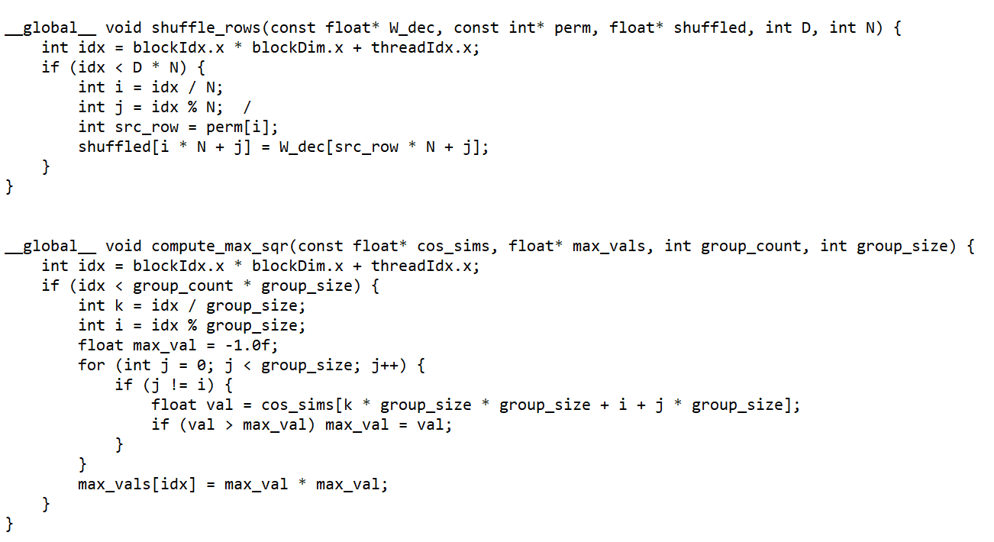
CUDA + cuBLAS + C++ implementation

Slide 8
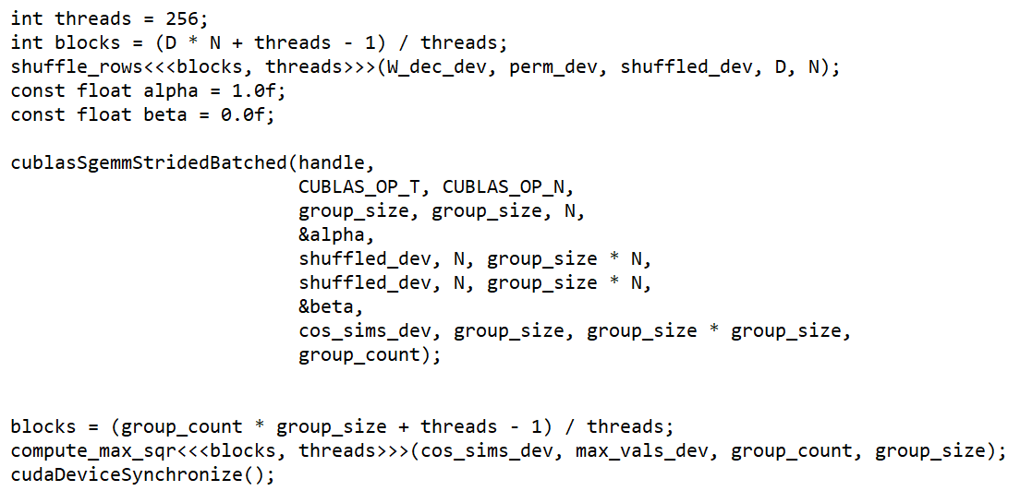
CUDA + cuBLAS + C++ implementation

Slide 9
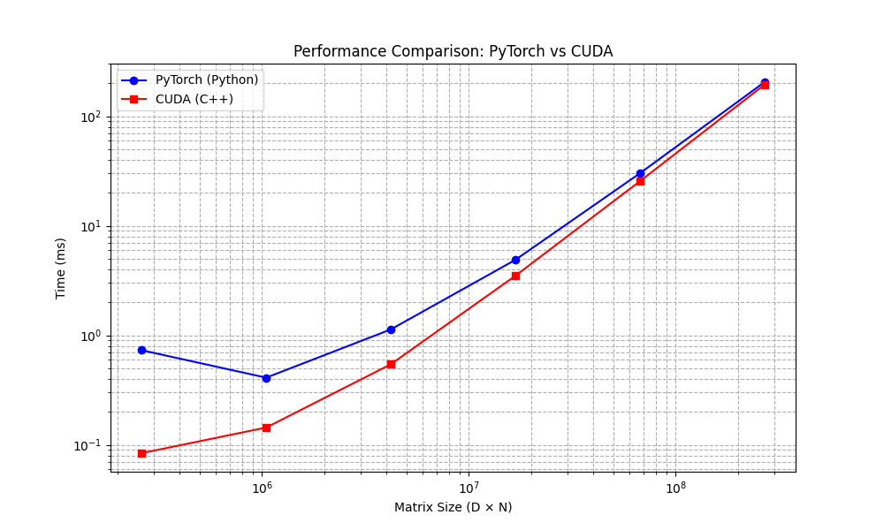
Comparison

Slide 10
Conclusion
Created efficient way to compute orthogonal regularization
2. Implemented it in 2 ways with:
a) Python with PyTorch
b) C++ with CUDA
3. Write everything in CUDA from scratch and beat PyTorch realization

